Slide 5
Headlines may be at most two line long and are set in Blue in Calibri style and font size is 30pt
Sub headlines can be in black, Font size is 18pt
EXAMPLE
The normal text is set in black and 18pt in size in Calibri style
  Bulleted lists have a blue point
    Indented bulleted lists
      Indented bulleted lists
        Indented bulleted lists
Legend 1
Legend 2
Legend 3
Legend 4
Legends should match the color of the chart; text is 12pt plain
Footnotes
  See bottom of page for correct use of footnotes
Stickers
  Stickers are used to denote “Selected Examples”, “Illustrative”, “Draft”, “Client Case Study”, “Estimate”, etc.)
  Stickers should be capitalized 16 point black, with line at top and bottom
  The sticker’s line length will be automatically adjusted according to the text length
  Stickers should be positioned at the top right of the “invisible grid”
EXAMPLE
¹ Footnote 1
2 Footnote 2
3 Footnote 3
Note: Note
Source: Maveric-Systems

Slide 6
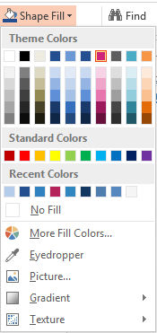
Colour scheme
255
255
255
0
0
0
238
236
225
35
78
143
108
153
214
35
78
143
208
36
123
94
94
94
75
172
198
247
150
70
Primary colours
  Colour
  The Maveric identity has primary colours that you can select for use in your communications. By using these colours consistently, it is easier for everyone to recognise the Maveric has approved a communication
  Text should use colours of good contrast so that the text is easy to read
  The primary colour is Maveric Blue which can be used to create a corporate look
  Presentations may look different when using an LCD projector. You may want to test slides ahead of time
Source: Maveric-Systems

Slide 7
Standard Table Format
Any of the two colour themes can be used, but should make it consistent
Line thickness 1pt with white colour

Slide 8
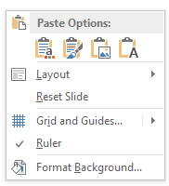
Copy and paste from different source
✓Use destination theme
✗ Keep source formatting
When you copy and paste slides from a different source, use destination theme to paste

Slide 9
Compendium of styles
  Typo
  Font Calibri
  Color of text Blue, Black
  Exhibit title Calibri 30pt
  Body text Calibri 18pt
  Diagrams Calibri 12-18pt
  Source info Calibri 10pt
  Graphics
  Lines and Borders
  No shades or 3D
  No cliparts
  Standard-closed arrowhead
  Connectors
  Separators
  Kicker box / Conclusion
  Black with ¾ line thickness
  Black with 1 ½ line thickness
  Dark gray with ¾ thickness
  Maveric Pink with 2 1/4 line
  thickness

Slide 10
The following guidelines for organization chart
The chart connector line thickness is 1 1/2
Left alignment
Left alignment
Left alignment

Slide 11
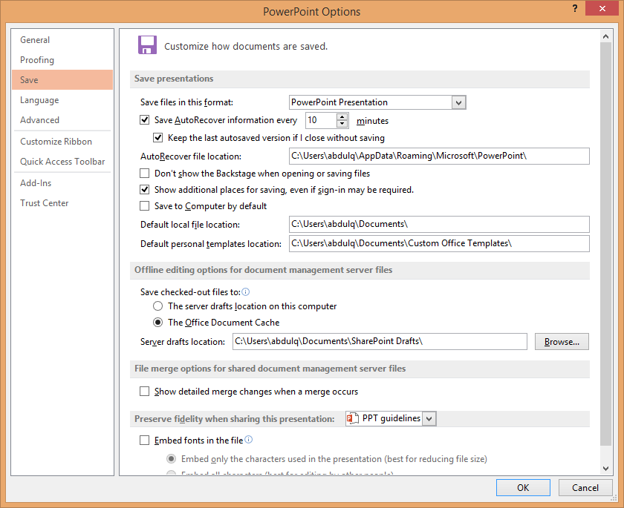
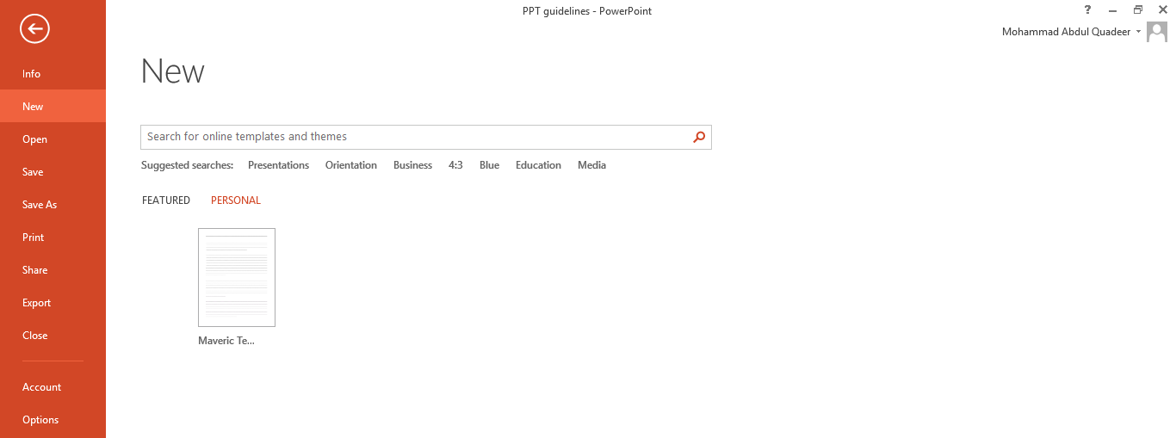
To save default templates in your personal folder

Slide 12
TITLE

